Slide 1
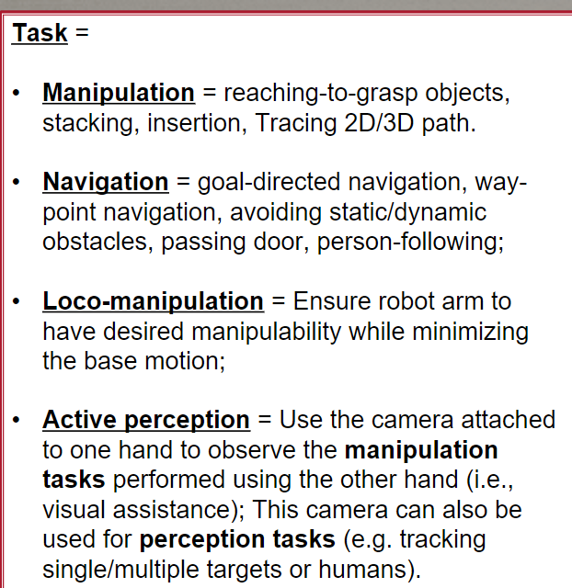
Project ideas

Slide 2
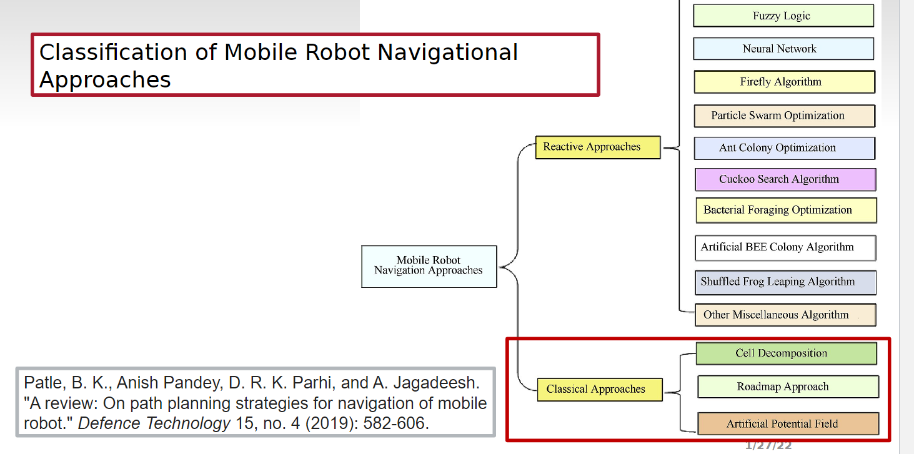
Navigation approaches

Slide 3
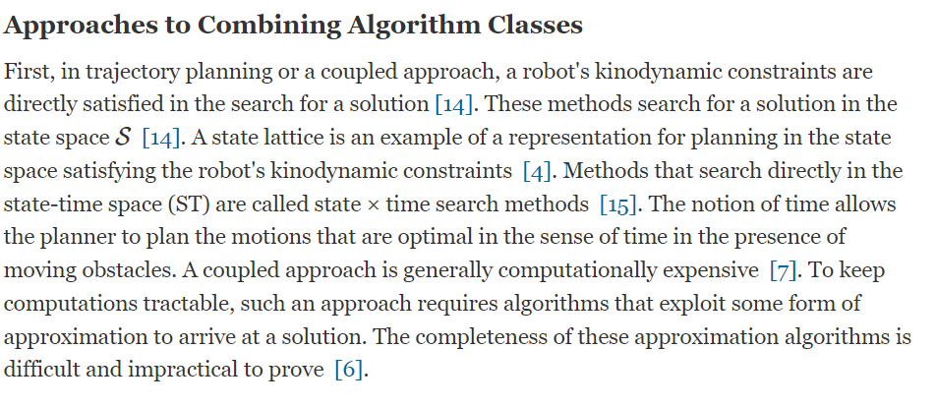
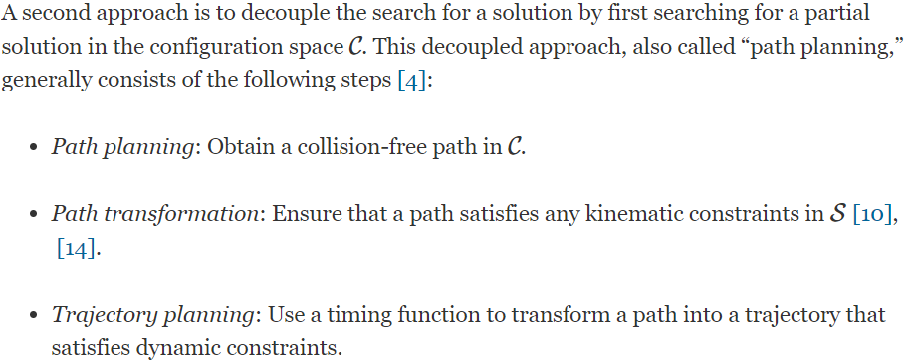
Excerpts from motion planning paper

Slide 4
Find out how to read environment
Find out sensory information
Find out how to localize our robot
Give a path planning solution that satisfies the following
Kinodynamic constraints
Trajectory planning
Controller to control the robot while moving

Slide 5
Concepts to clarify
Reading map data
Reading sensory data
Understanding motion planning approach
paper1
Understand input required for reactive approaches
Path planning approach
Trajectory optimization

Slide 6
Papers to review
Algorithms for collision avoidance in navigation
Motion planning review paper for mobile robots
Path planning algorithms survey
Chapter 11 – Intro to mobile robot control
To do :
Read prescribed papers
Melodic installation
Run unity and check it out

Slide 7
Questions to be answered
Unity | 1.Gathering sensory data 2.How to read the map 3.Can a ultrasound sensor or something be used in unity simulation itself?
Path planning | Reactive approaches come under sampling?

Slide 8
Meeting minutes – 01/30/2022
TO do
Melodic system installation, unity basic checks: group 01/30/2022
Algorithm paper – Ajith reading and summary: 01/30/2022
01/31/2022

